Slide 1


DESIGN 1
Lesson 1: Headings & Paragraphs: Structuring Text
Ms. Abboud • Grade 9 - Design 1 • Term 1, Week 3

Slide 2
Learning Objectives
WALT - We Are Learning To
WILF - What I'm Looking For
Use heading tags (h1-h6) to structure a webpage in a clear hierarchy.
Use paragraph tags (<p>) to group related sentences together.
Can use h1 for the main heading and h2 for section headings, in order.
Can explain the difference between <h1> and the <title> tag.

Slide 3
Academic Vocabulary
Heading
Paragraph
Tag (h1-h6) that labels a page or section - h1 biggest, h6 smallest. Not the same as <title> (browser tab text).
The <p> tag - groups a block of related sentences together as one unit of text.
Hierarchy
An ordered structure from most to least important - how heading levels (h1 > h2 > h3) organize a page.

Slide 4
Frayer Model: Hierarchy
DEFINITION
CHARACTERISTICS
An ordered structure from most to least important, used to describe how heading levels organize a page.
h1 is biggest/most important; levels get smaller as they matter less; never skip a level (e.g. h1 straight to h4).
HIERARCHY
EXAMPLES
NON-EXAMPLES
<h1>My Website</h1>
<h2>About Me</h2>
<h2>My Hobbies</h2>
<h1>My Website</h1>
<h4>About Me</h4>
(skips h2 and h3)

Slide 5
National Identity Integration
Effective Digital Communication: a clearly structured webpage, with a strong heading hierarchy, communicates a message quickly and professionally - a skill Emirati students carry into any digital career, from government e-services to private-sector web content.

Slide 6
STARTER
Which Page Would You Actually Read?
Compare a wall of unformatted text to the same content broken into headings and paragraphs.
Turn and talk: which one would you read, and why?
Hook • Engage & Ask
5 - 10 minutes

Slide 7
LESSON CORE
I Do: Teacher Demo
Headings (h1-h6) build a hierarchy; paragraphs (<p>) group related sentences.
<title> sets the browser tab text - <h1> is the big visible heading on the page. Not the same tag.
Gradual Release of Responsibility
30 - 40 minutes
Example: a page with correct heading hierarchy
<h1>My Website</h1>
<p>Welcome to my personal site.</p>
<h2>About Me</h2>
<p>A short paragraph about who I am.</p>
<h2>My Hobbies</h2>
<p>A short paragraph about what I enjoy doing.</p>
1 / 3

Slide 8
LESSON CORE
We Do: 3 Reads of the Example
Apply the 3 Reads to the page on the right: what's it about, which ideas go where, and why is it easier to read than the warm-up's wall of text?
Gradual Release of Responsibility
30 - 40 minutes
The example page, rendered
My Website
Welcome to my personal site.
About Me
A short paragraph about who I am.
My Hobbies
A short paragraph about what I enjoy doing.
2 / 3

Slide 9
LESSON CORE
We Do: 3 Reads of the Example
Apply the 3 Reads to the page on the right: what's it about, which ideas go where, and why is it easier to read than the warm-up's wall of text?
Gradual Release of Responsibility
30 - 40 minutes
The example page, rendered
My Website
Welcome to my personal site.
About Me
A short paragraph about who I am.
My Hobbies
A short paragraph about what I enjoy doing.
2 / 3

Slide 10
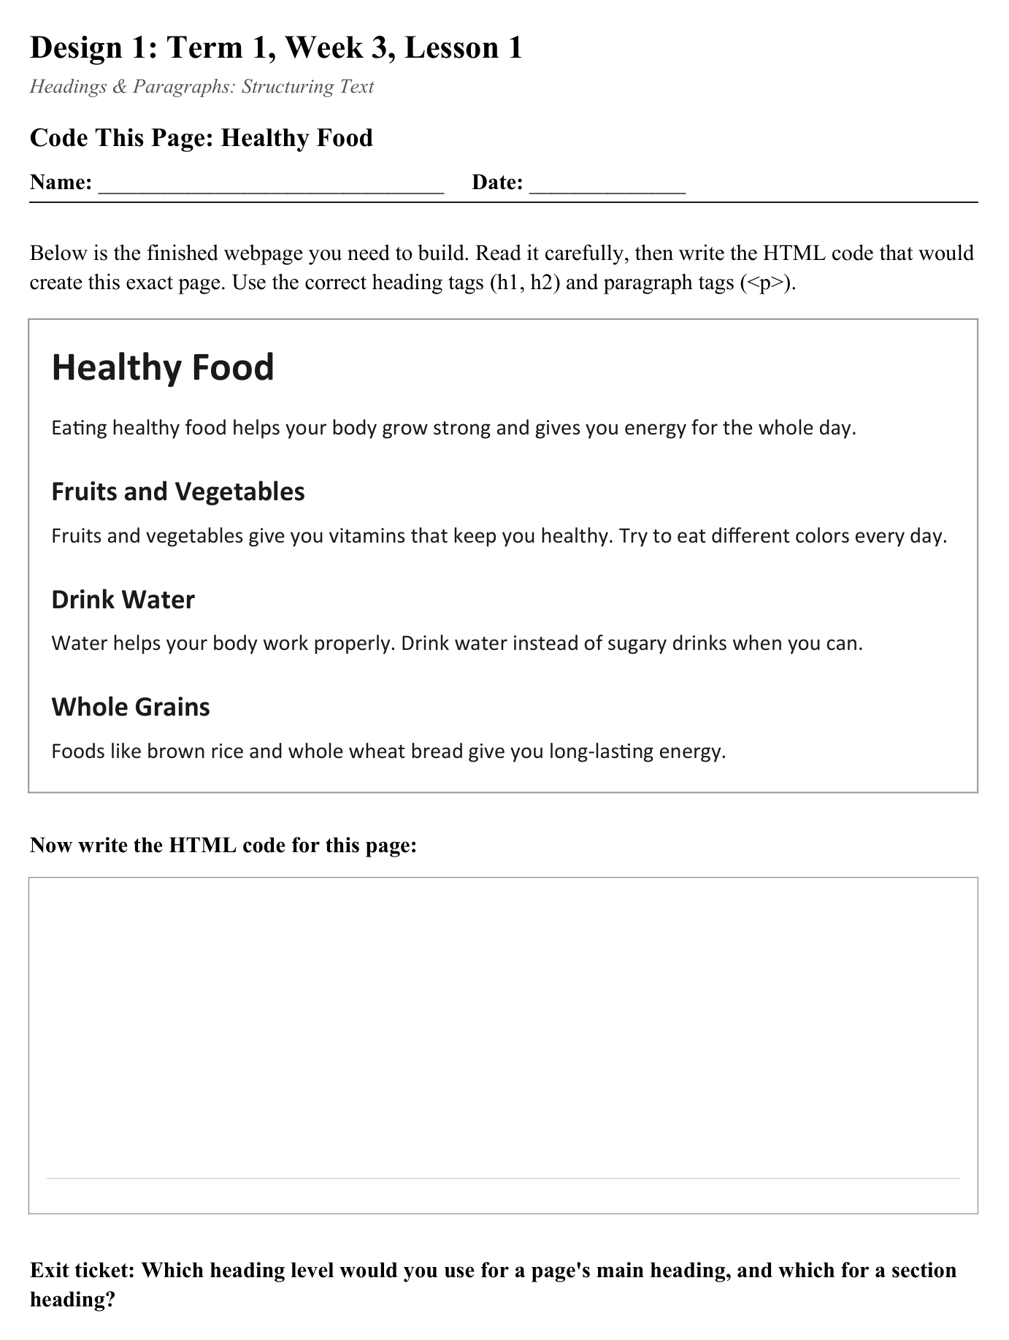
LESSON CORE
You Do: Code the Healthy Food Page
You're given the finished webpage - write the HTML code that would build it, using the right heading and paragraph tags.
Activity: Code This Page - Healthy Food
Gradual Release of Responsibility
30 - 40 minutes
3 / 3

Slide 11
CLOSURE
Exit Ticket
Which heading level would you use for a page's main heading, and which for a section heading?
Which tag would you use to set the browser tab text instead?
Transition & Extend
5 - 10 minutes

